Slide 1

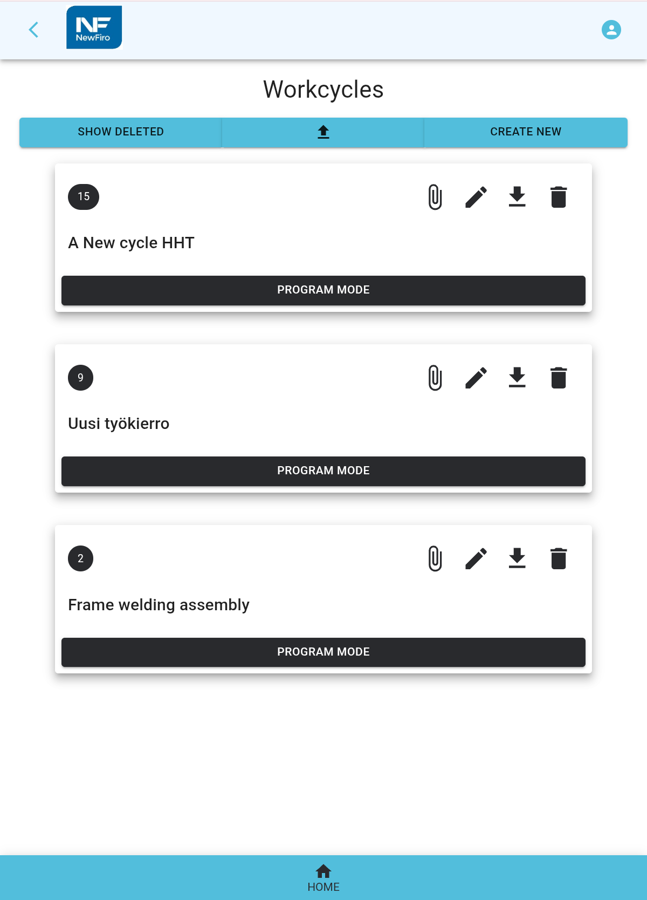
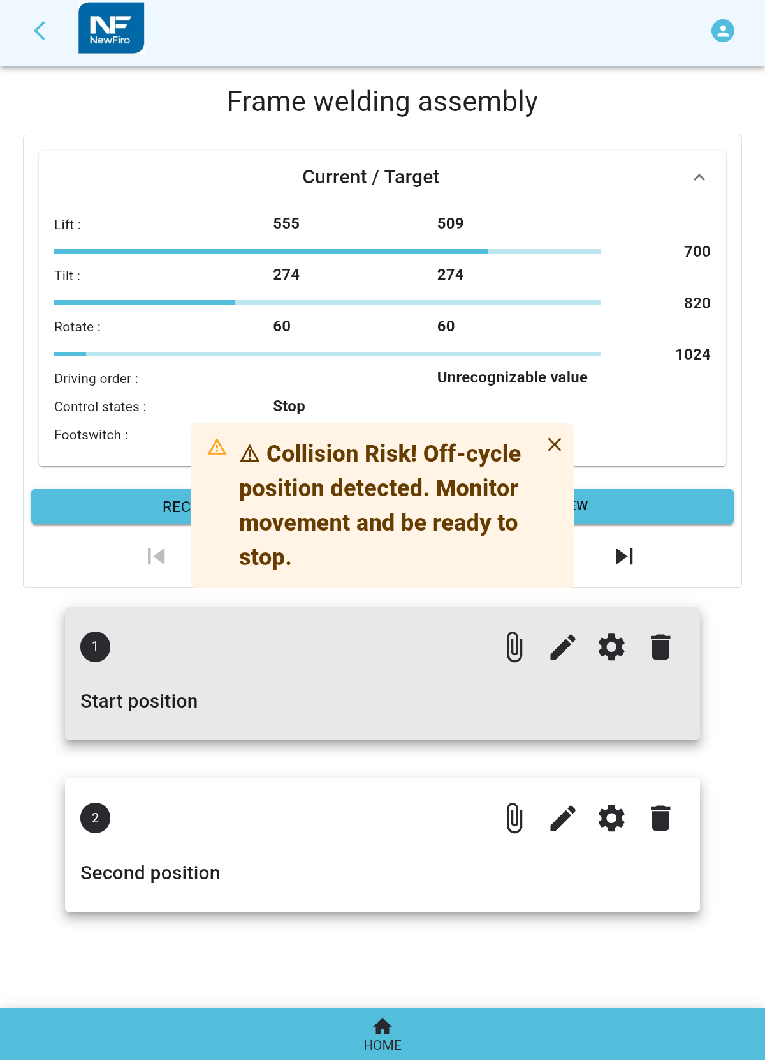
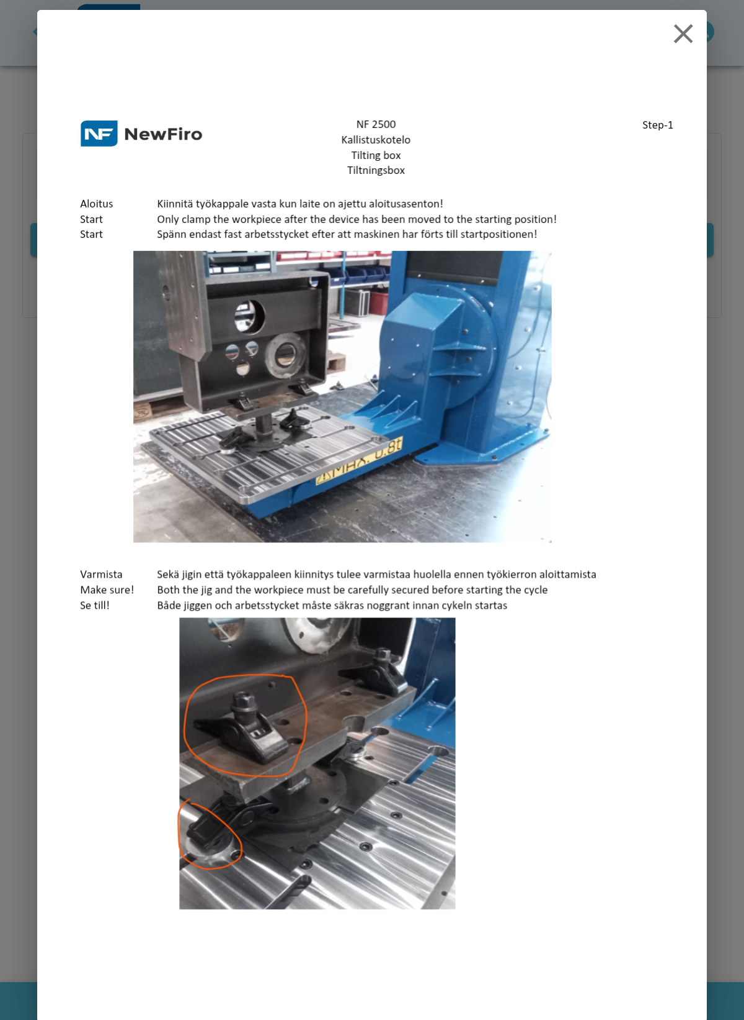
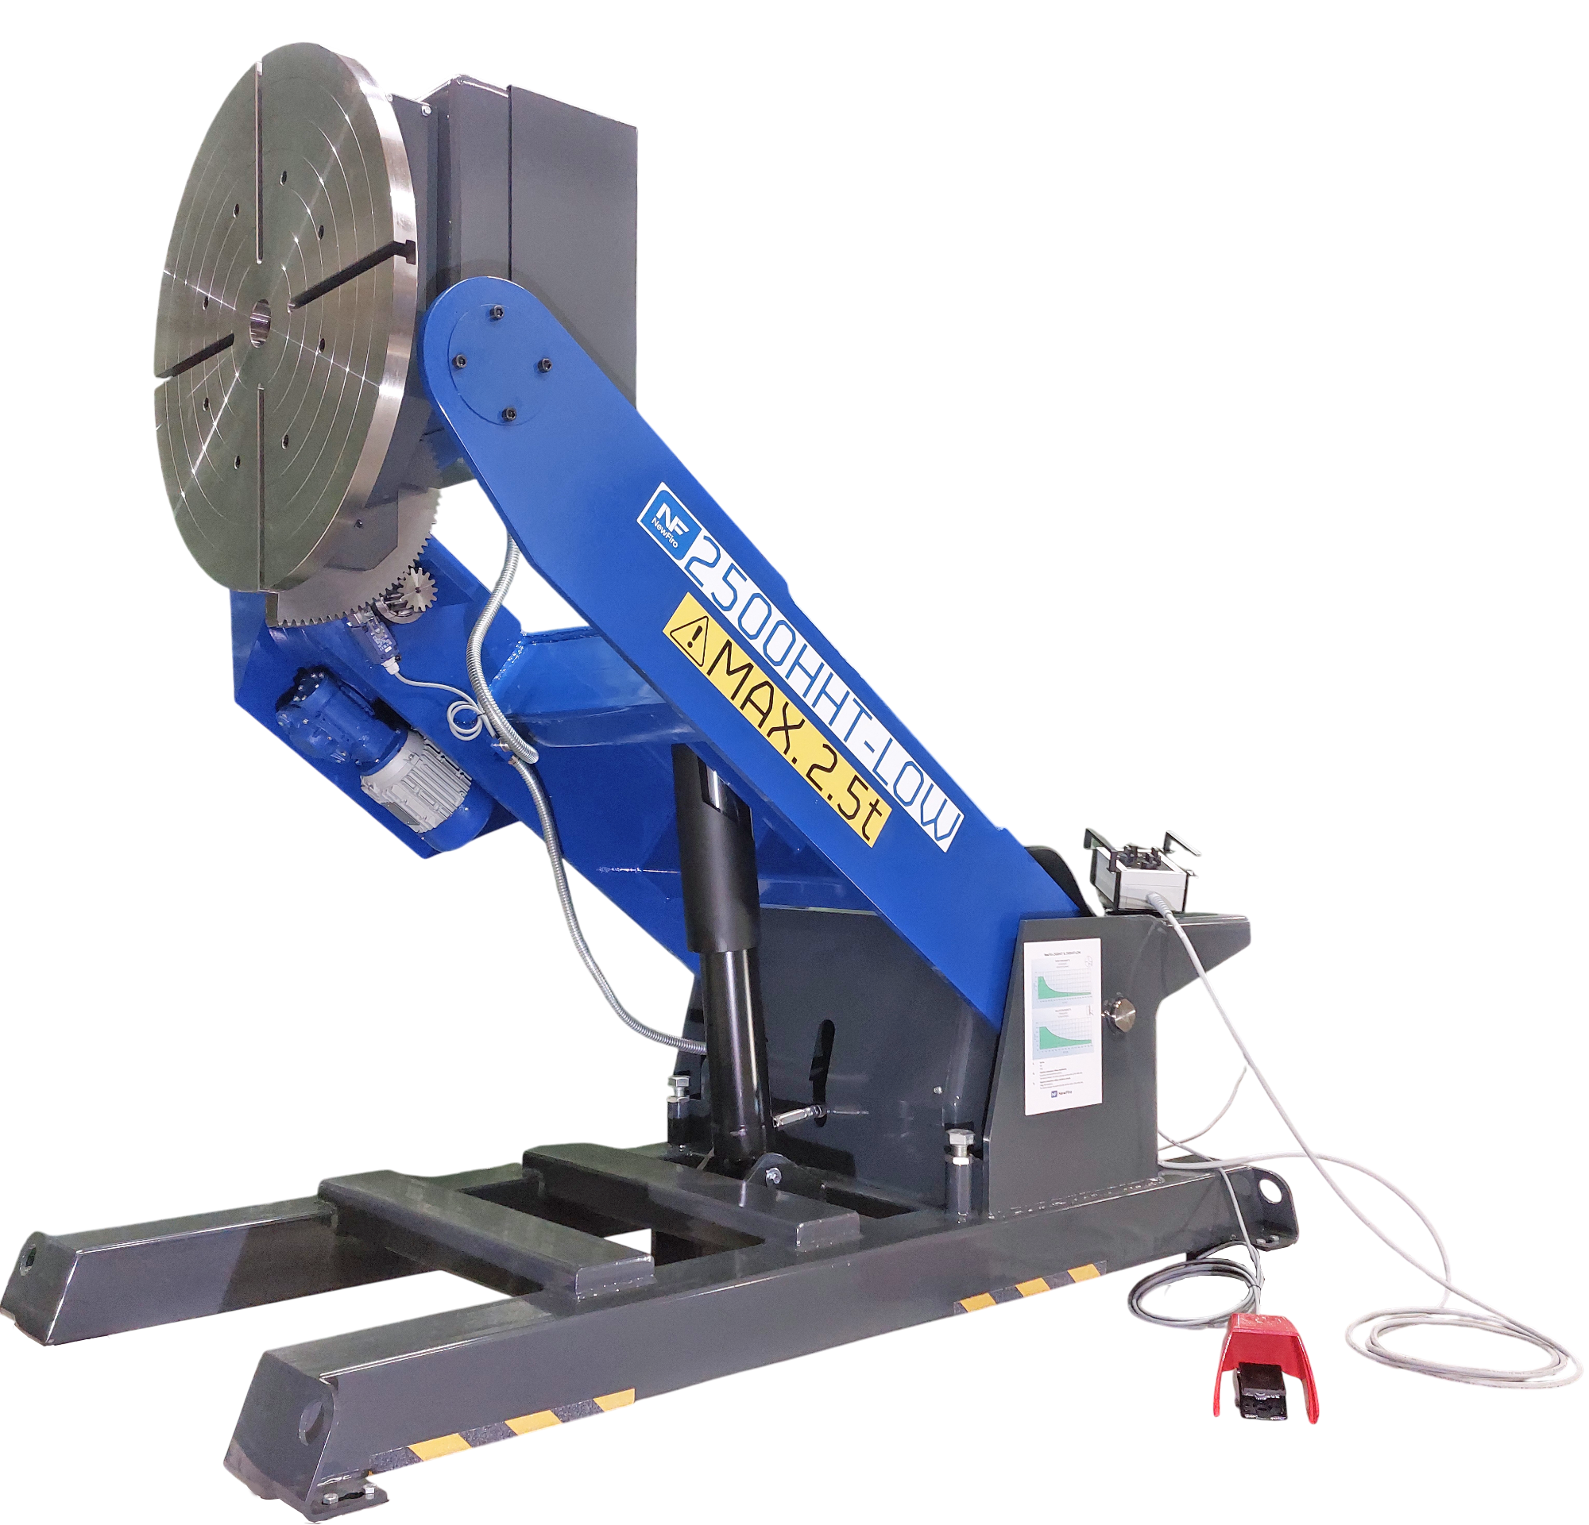
Smarter
piece handling
Pentin Paja Oy · www.newfiro.fi

Slide 2

Introduction to SmartFiro for NewFiro piece positioners
Programmable and adjustable work cycles
Browser-based control
Easy access to Standard Operating Procedures
2
02

Slide 3
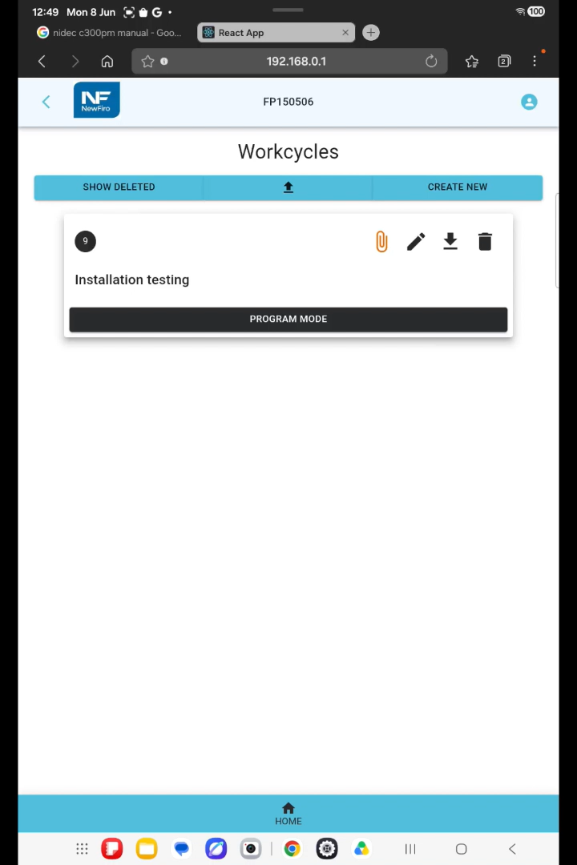
Programming a work cycle
1
2
3
4
5
Move
Save
Attach
Sequence
Repeat
Position the workpiece manually.
Store the work position.
Add images or work instructions.
Reorder or insert positions.
Benefits for Team Leaders & Process managers
Easy to program, copy, and adapt for similar workpieces
Simple transfer between comparable positioners
Flexible welding sequence adjustment
Standardised processes and know‑how
Faster operator training
Capture and share tacit knowledge
03

Slide 4
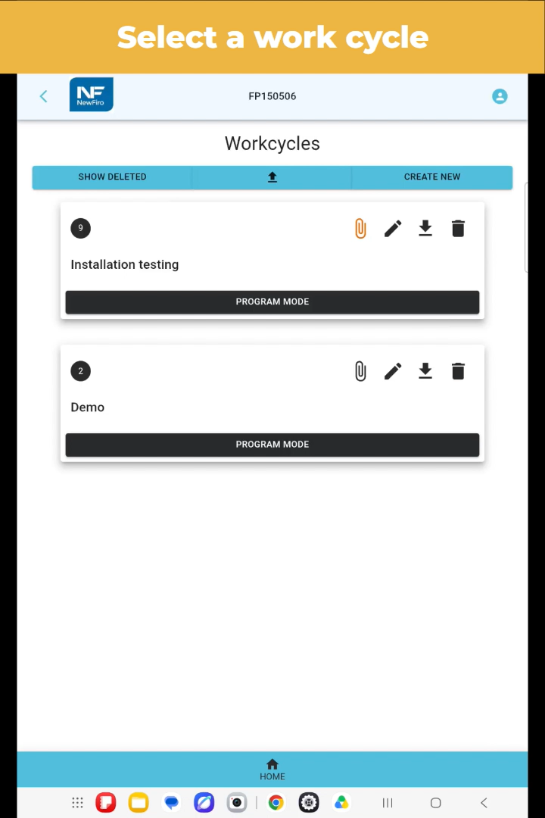
Running a work cycle
1
2
3
4
5
Start
Move
Read
Do
Next
Secure your piece and choose a work cycle
Select the work position and press the foot pedal
Check warning messages and work instructions
Perform welding according to instructions
Operators benefits
Fast, precise positioning between welds
Minimal need for manual adjustment
Less trial and error
Instructions available at the right moment
04

Slide 5
NewFiro + SmartFiro = From challenge to repeatable results
Standardise positioning
Stabilise your process
Involve and improve
Same work cycle and positioning every time, independent of operator
Standard Operating Procedures accessible where and when it’s needed
Less dependency on operator experience
Secure consistent weld quality
Less rework
Faster training for new operator
Easy to program
Easy to adjust sequence order
Collect and transmit silent knowledge
Unlock more performances from the machine you already have
05

Slide 6
SmartFiro in a nutshell
Smart programmable work cycles for NewFiro piece positioners
3 position sensors: 2 angle sensors and 1 draw wire
Programmable Logic Controller (Crouzet)
Control computer (Raspberry Pi4)
Wireless input device
Browser-based control user interface
Operate via tablet, PC or smartphone
Retro-fit option
Flexible work cycle: easy way to adjust the work position sequence order.
Flexible work position: positions can be modified as need, contain attachments like pdf or images.
Safe: foot switch and warning message options
Scalable: transfer work cycle to similar NewFiro piece positioner with minimal adjustment
Supports LEAN manufacturing
Source: Pentin Paja Oy, NewFiro piece positioner equipment and SmartFiro product pages.
06

Slide 7
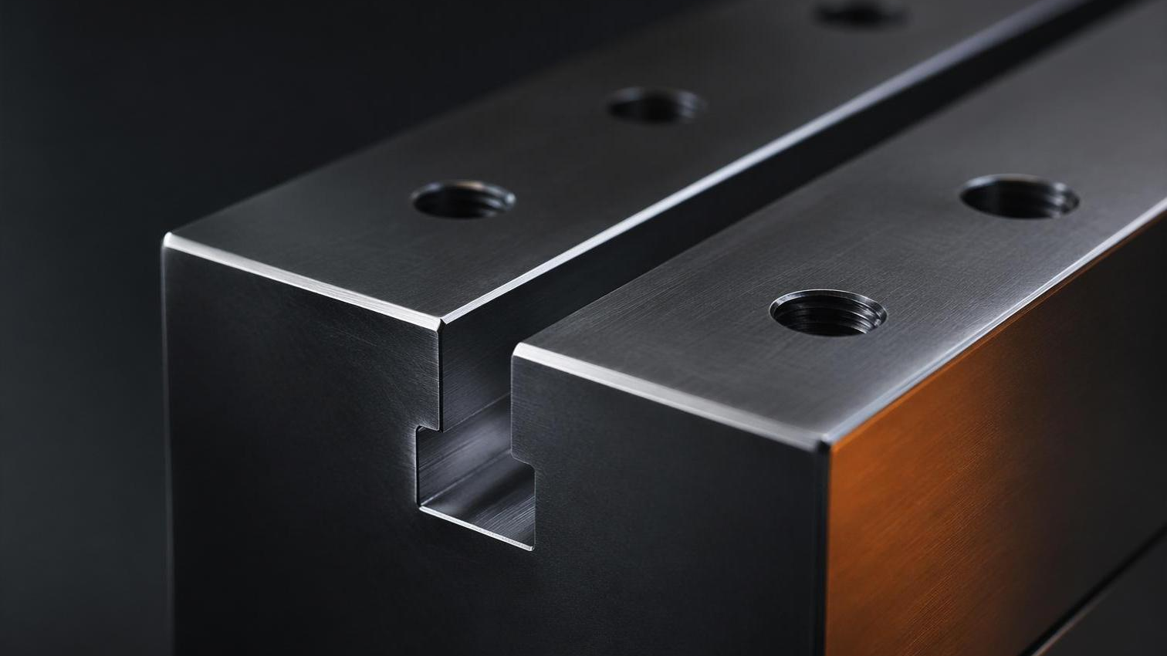

SmartFiro
Program the position
Repeat the quality
Request an offer · www.newfiro.fi · info@pentinpaja.fi

